Slide 1
Ggplot2 and interactive graphics with R
Christophe Ladroue
SECTION 04
Trends and big data
www.PacktPub.com

Slide 2
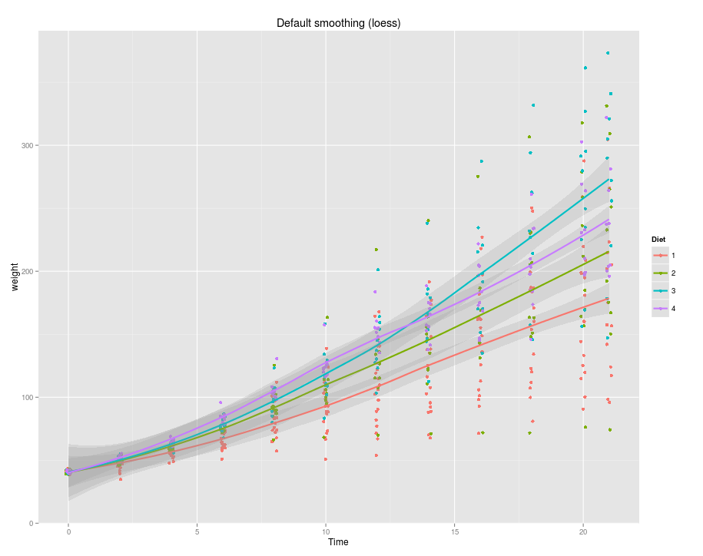
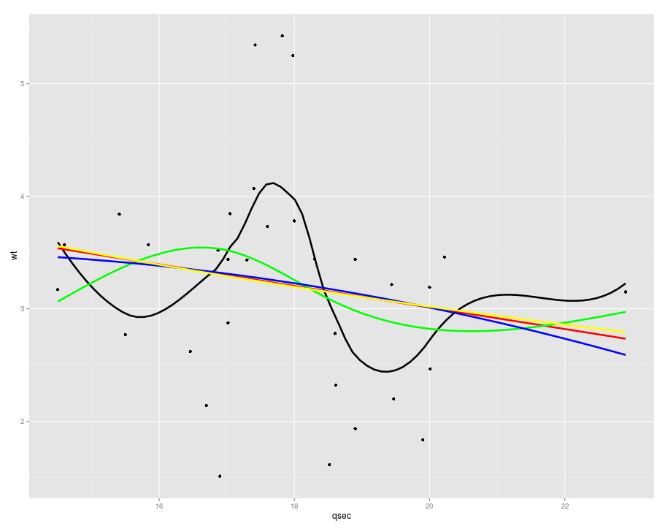
In this video we took a look at
how to fit and add a default polynomial regression (loess) to a scatter plot.
how to fit and add a linear model to a scatter plot.
Next: non-linear trends

Slide 3
In this section we’re going to take a look at
Linear and polynomial fits.
Non-linear fits.
Using stat_function to overplot a user-defined function.
Big data with bigvis: binning and condensing
Big data with bigvis: smoothing and peeling

